Slide 1

VIBRATION ANALYSIS FOR PUMP HOUSE-3
Date: 02/12/2023
Presented by- Group 5
CASE PG2 & PDM

Slide 2
PROBLEM STATEMENT
Context:
PUMP Houses are often mounted with high capacity pumps to operate continuously with minimum monitoring and care. The continuous run of pumps create impact on the structures or buildings that the pump are housed.
Problem Statement: Assessing the Effects of Pump Vibration on the accessories environments like Discharge sections, base and adjacent Area.

Slide 3
MOTIVATION
Ensuring Optimum Efficiency & Daily Health Monitoring
There is often a fear or doubt in mind of an engineer regarding the vibration caused by pumps in the connected structural elements.
One need to provide that much “capacity” in terms of reinforcement and material to the related structural elements so that the vibration of pump do not affect the workability of these structural elements.

Slide 4
OBJECTIVE – Structural Health Monitoring
Power Efficiency of pump: The goal is to finding out the power efficiency of pump.
Concrete strength check: The goal is find out the strength efficiency of concrete throughout the life-time of its functionality.
Distribution of energy: To check the transfer of acceleration from pump motor to concrete block and pipe which is carrying the suction water.

Slide 5
EQUIPMENT REQUIRED
ESP 32 — Processor for whole circuit
2 x MPU 6050 sensor - Accelerometer Sensors for measuring Vibration in three axis
Mountings & casings - One main casing for mounting the processor and two mini casings for mounting the sensors
Connecting wires - for connecting sensors to Processor Board
Zero PCB Board - A place for holding and soldering the final circuit in the main casing

Slide 6
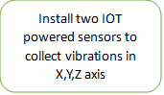
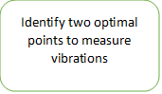


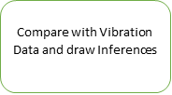
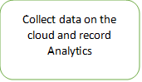

BLOCK DIAGRAM

Slide 7
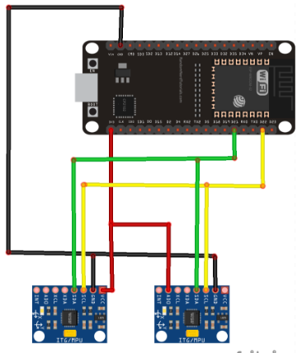
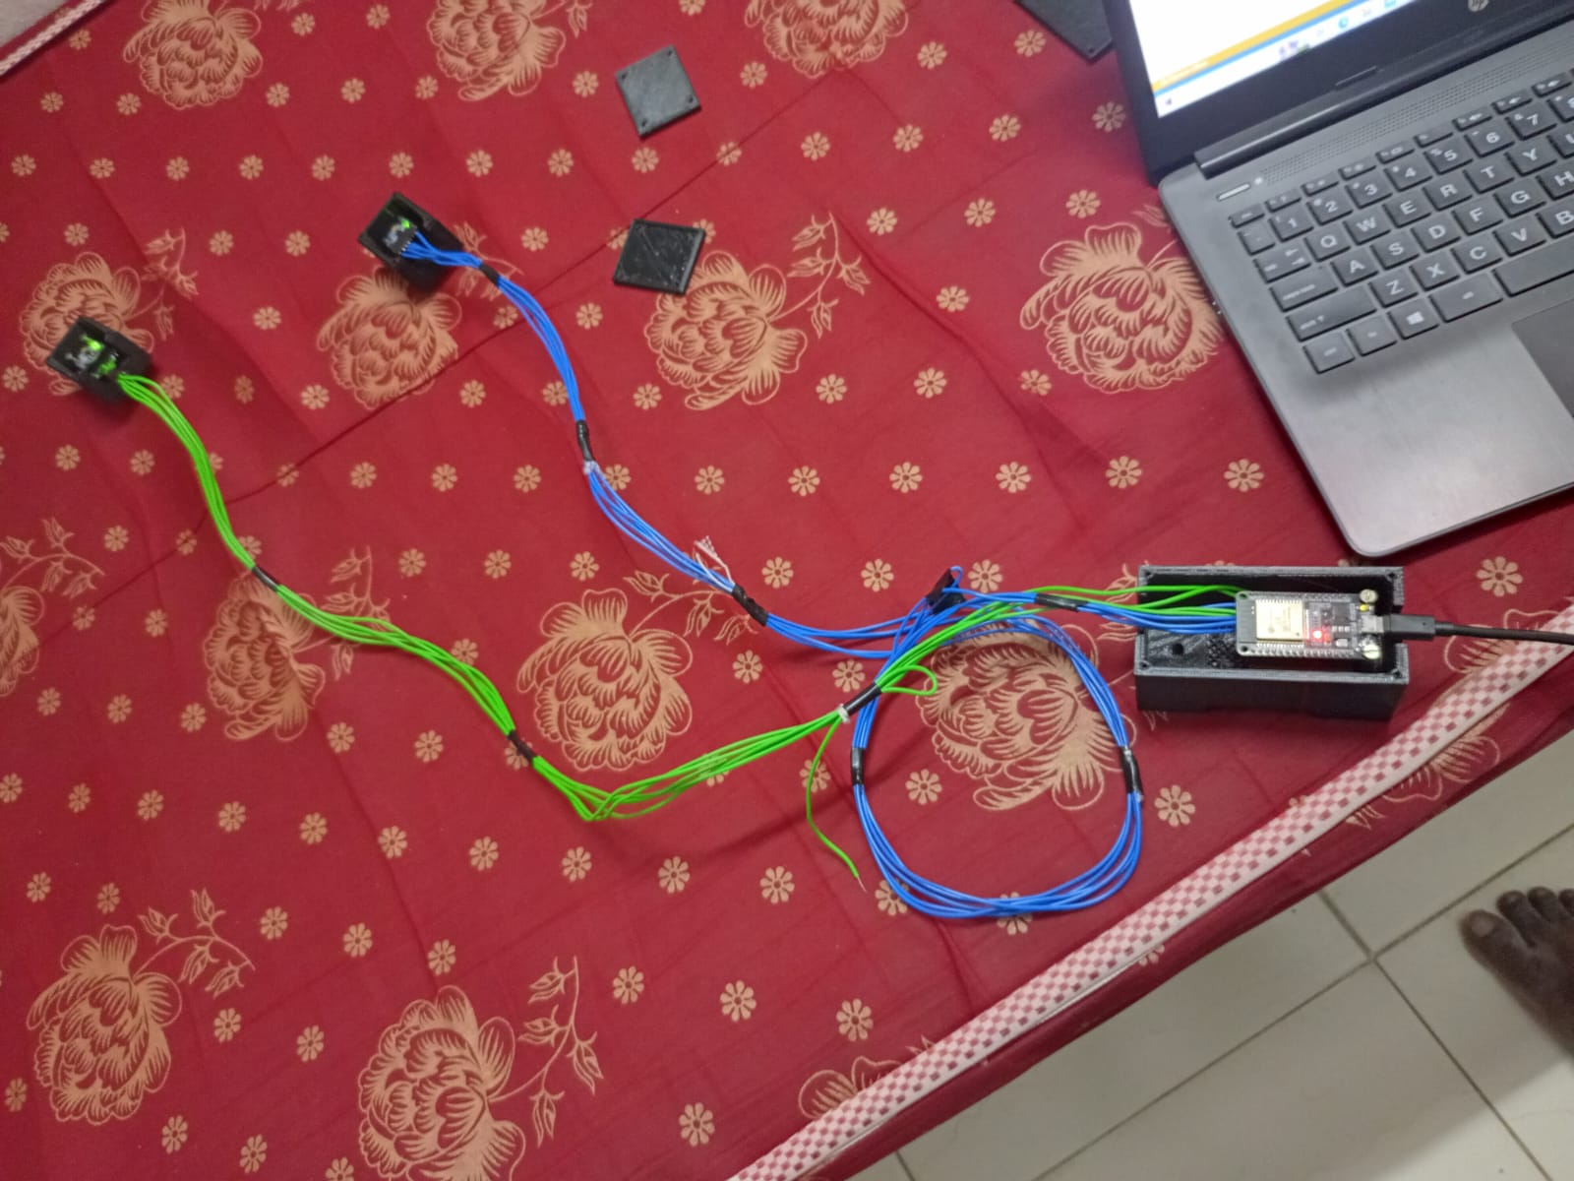
CIRCUIT DIAGRAM

Slide 8
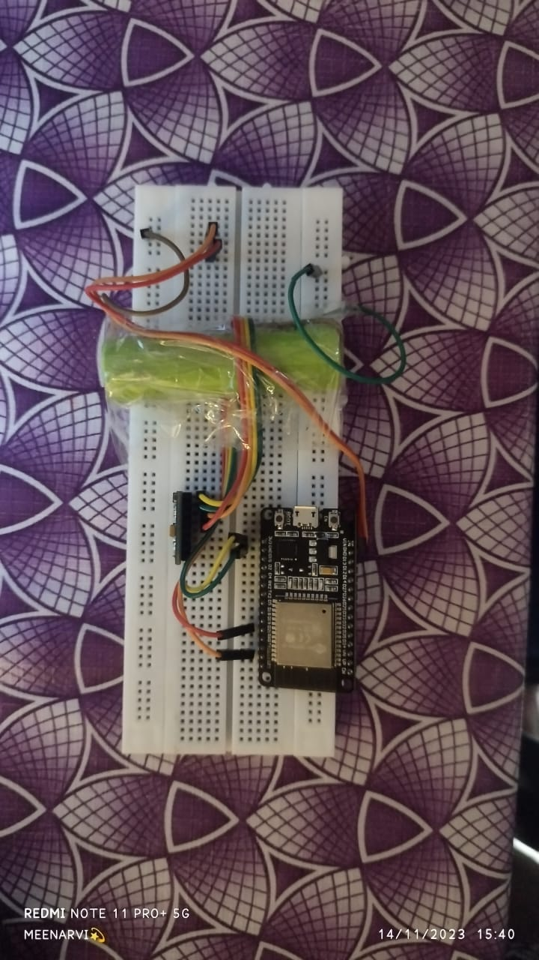
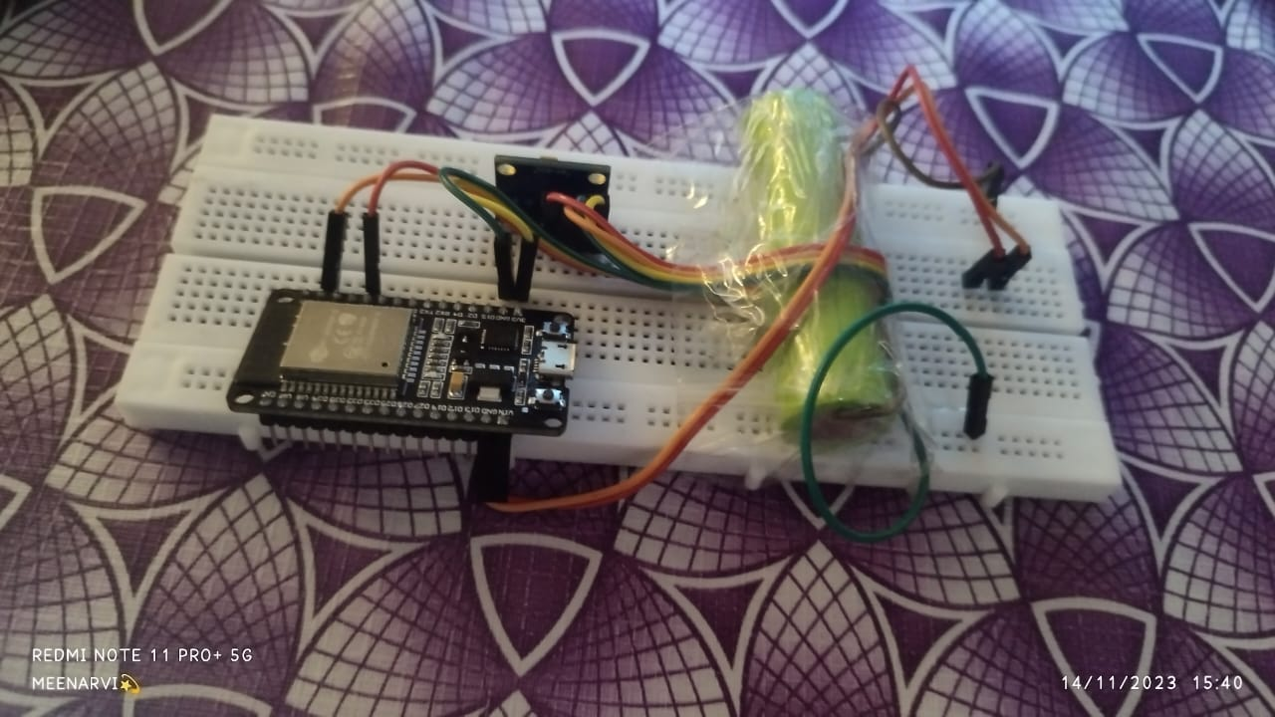
CIRCUIT DIAGRAM

Slide 9
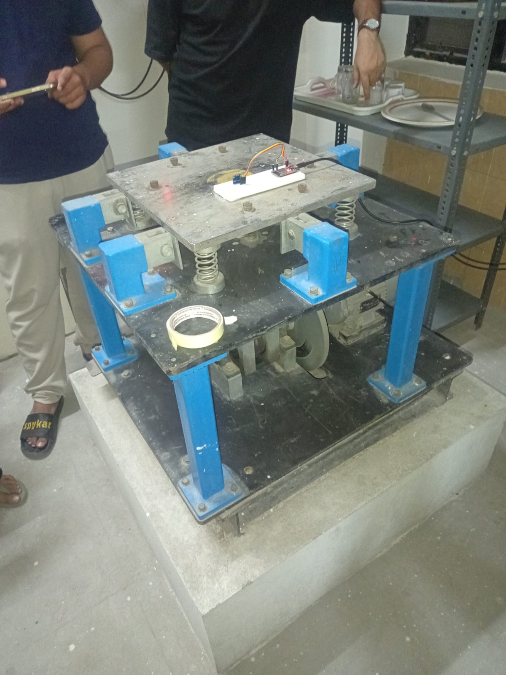
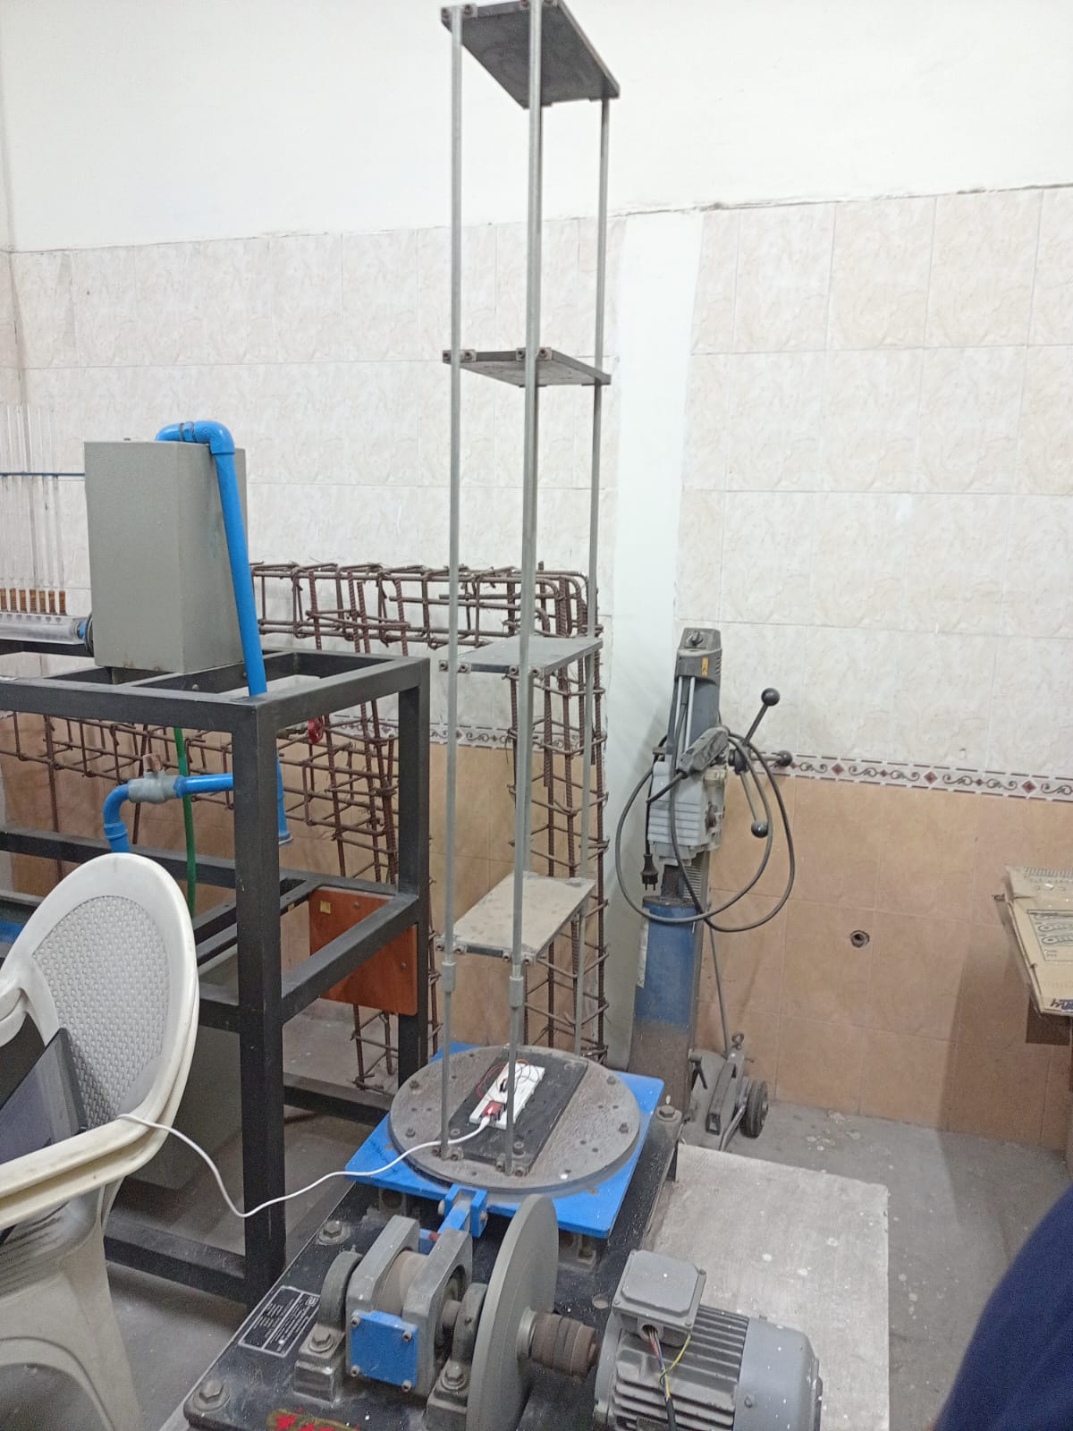
SHAKE TABLE VIBRATION ANALYSIS
Vertical Shake Table
Horizontal Shake Table

Slide 10
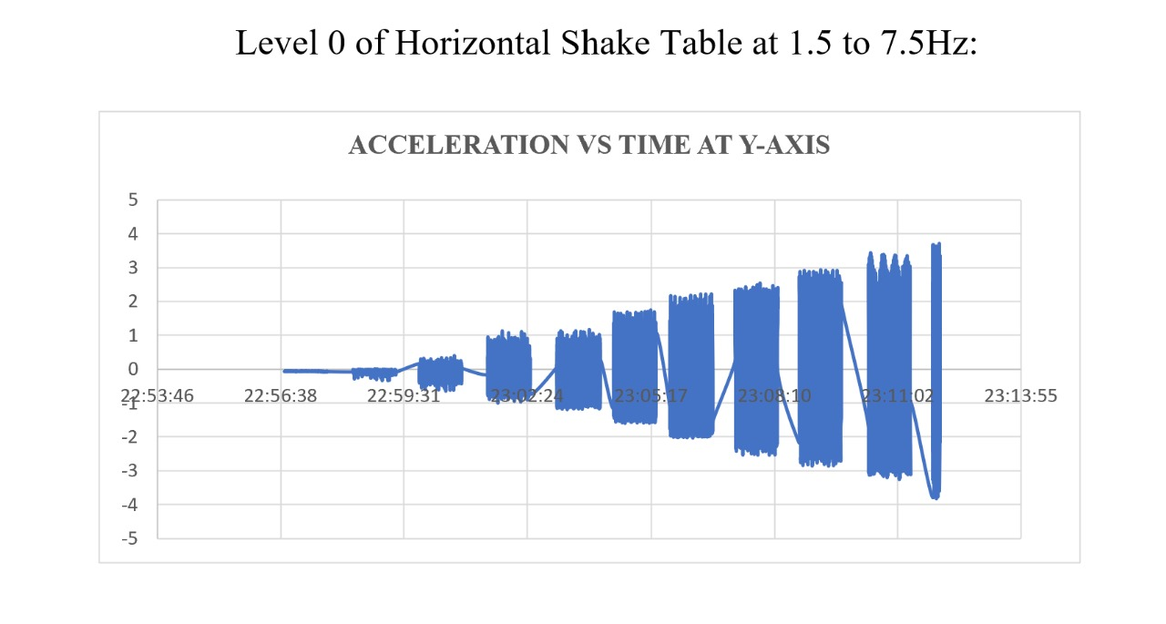
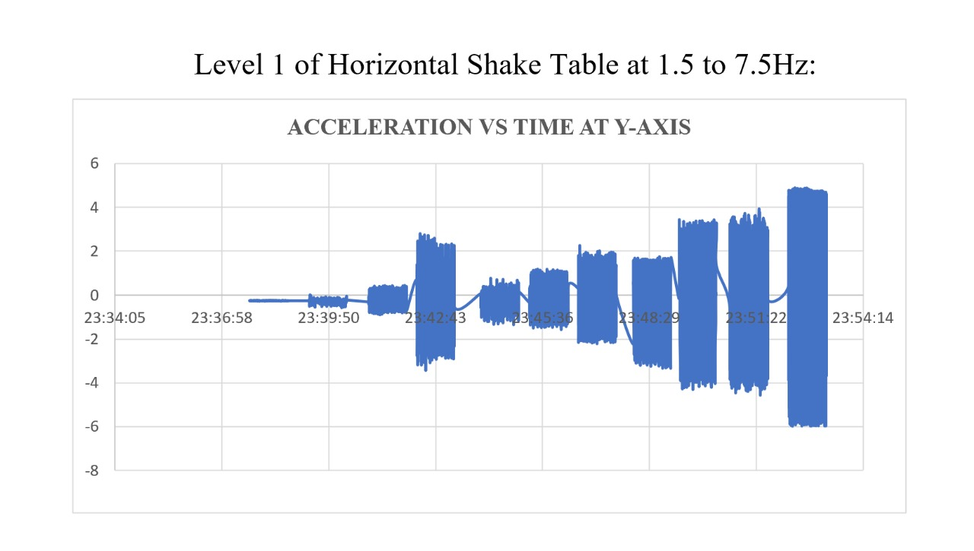
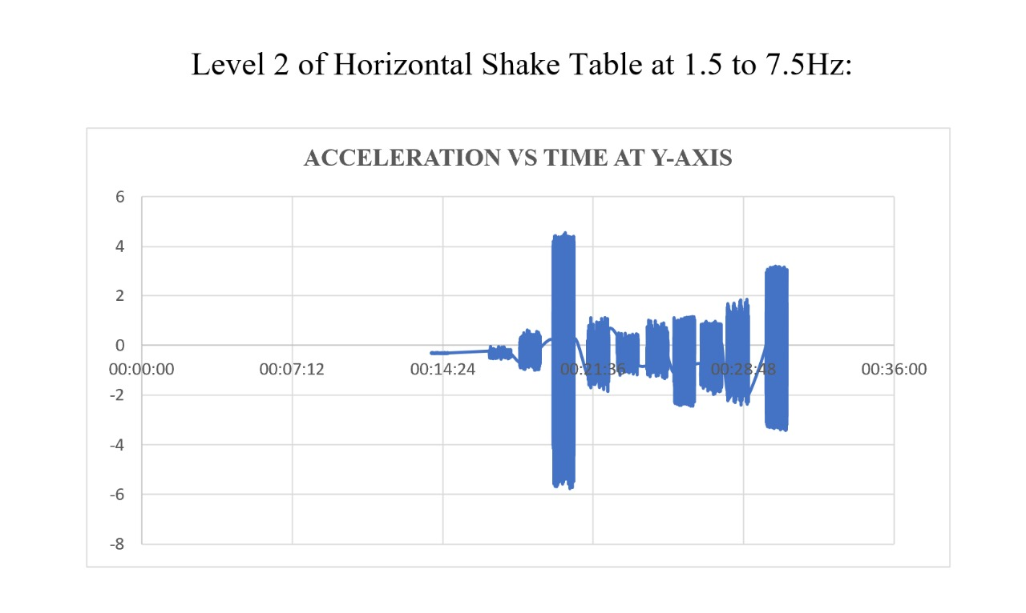
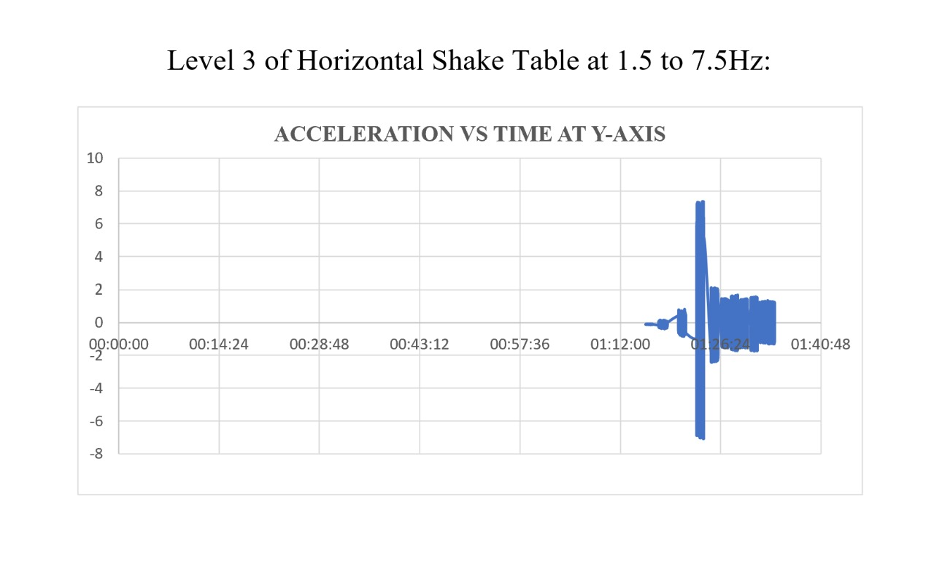
SHAKE TABLE VIBRATION DATA

Slide 11
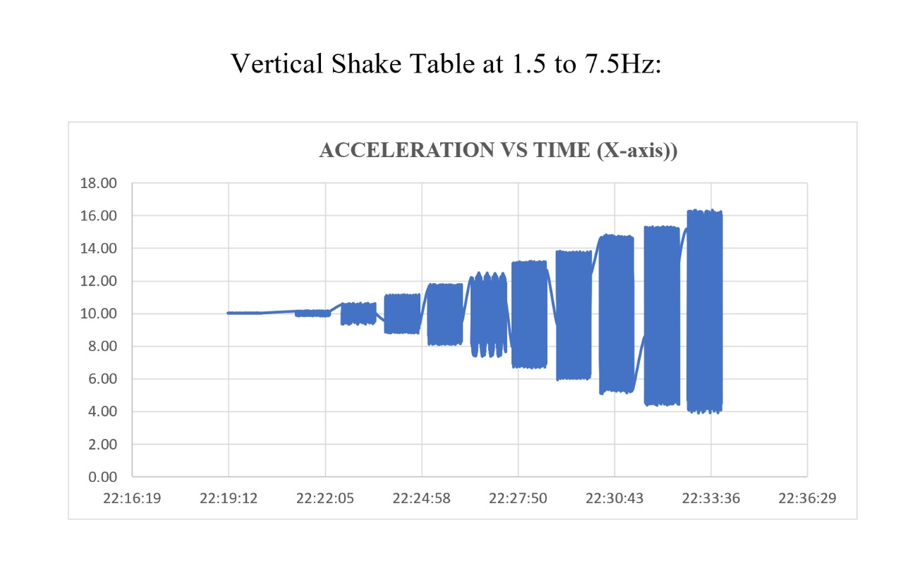
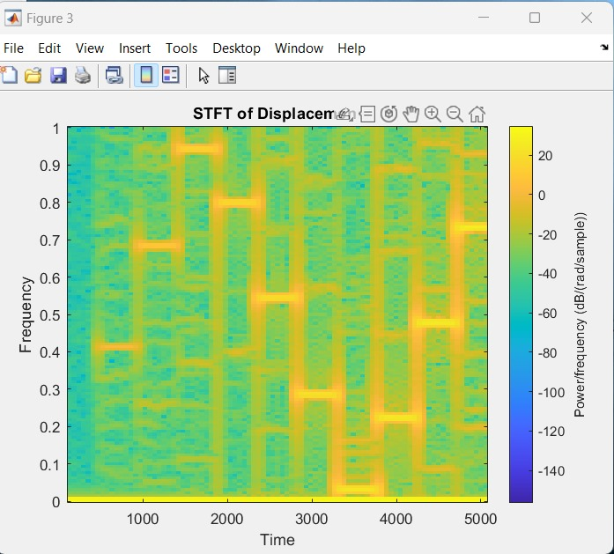
SHAKE TABLE VIBRATION DATA ANALYSIS
Spectrogram for Vertical Shake Table

Slide 12
ANALYSIS OF SHAKE TABLE DATA
Horizontal Shake Table Data
Frequency varying from 1.5Hz to 7.5Hz (with 1Hz variation)
As the frequency increases acceleration also increases.
Vertical Shake Table Data
Frequency varying from 1.5Hz to 7.5Hz(with 1Hz variation,at all the five floors)
At the ground as the frequency increases acceleration also increases.
At different floors there is sudden increases in the acceleration because the structure reaches its resonance frequency.

Slide 13
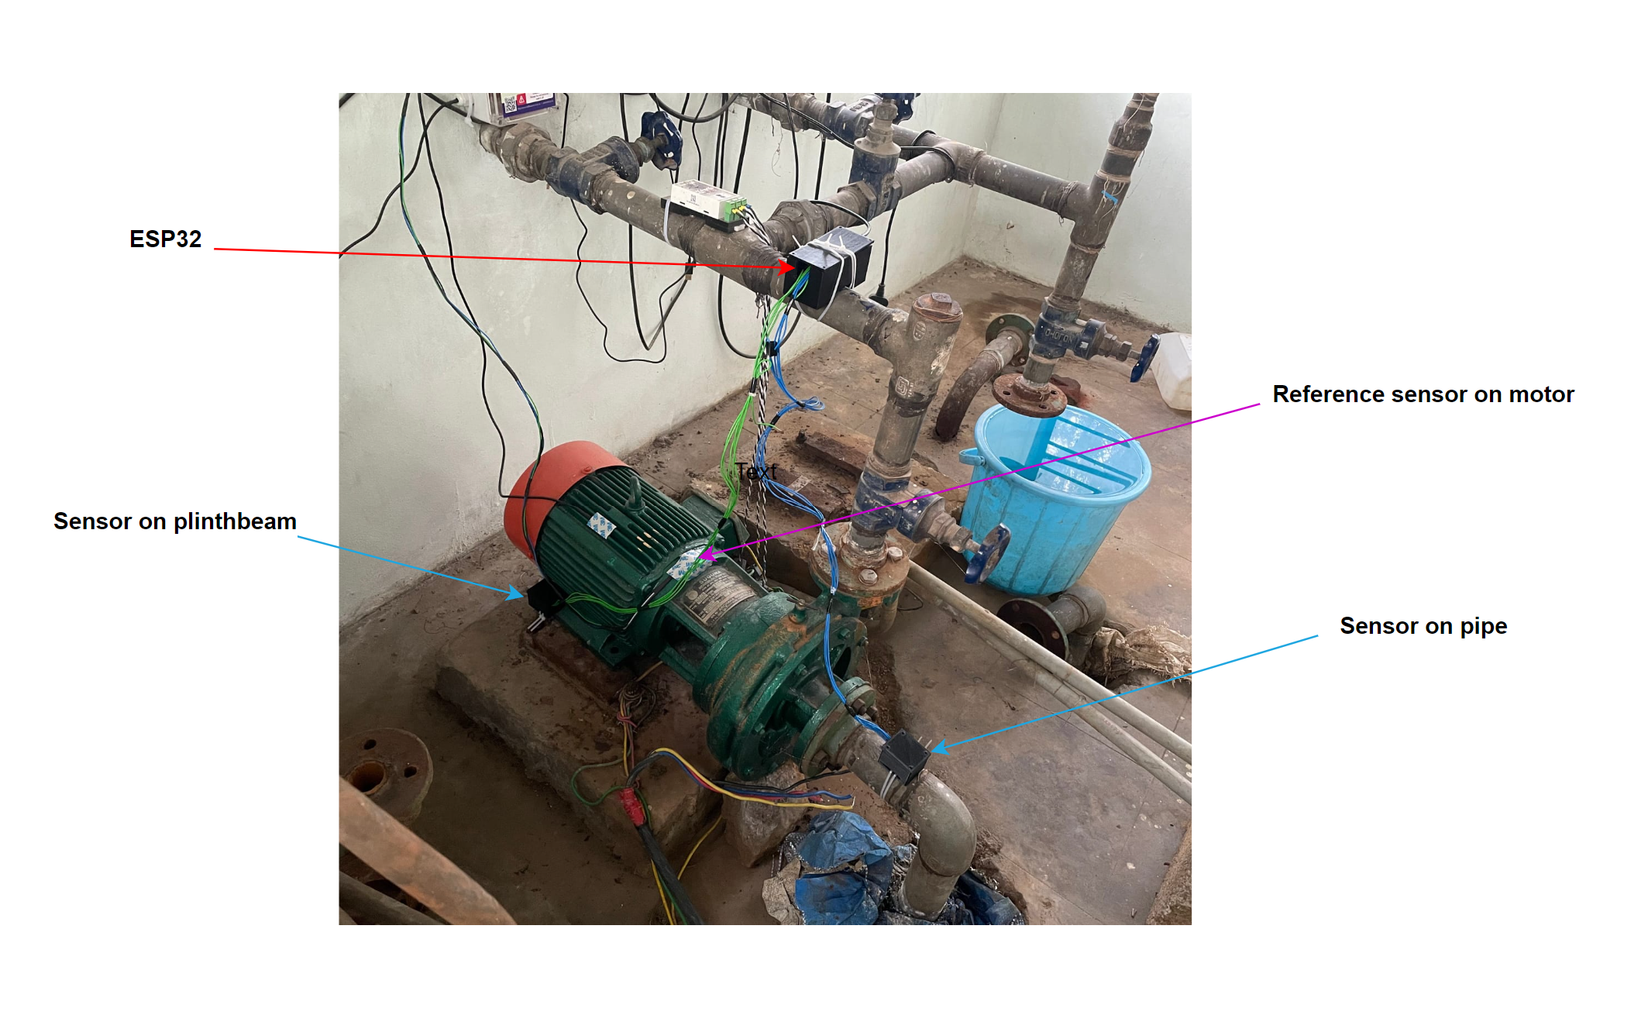
PLAN FOR DEPLOYMENT
Deployment Location: Pump House 3
Deployment On:
On the Pump water pipe
On the Plinth (Concrete Block)

Slide 14
PLAN FOR DATA COLLECTION
Through the Accelerometer, we are measuring in each of the 3 axis - X,Y,Z
The data has been collected through “Thingspeak”, as 3 readings in 1 minute from 20th November 2023 to 26th November 2023

Slide 15
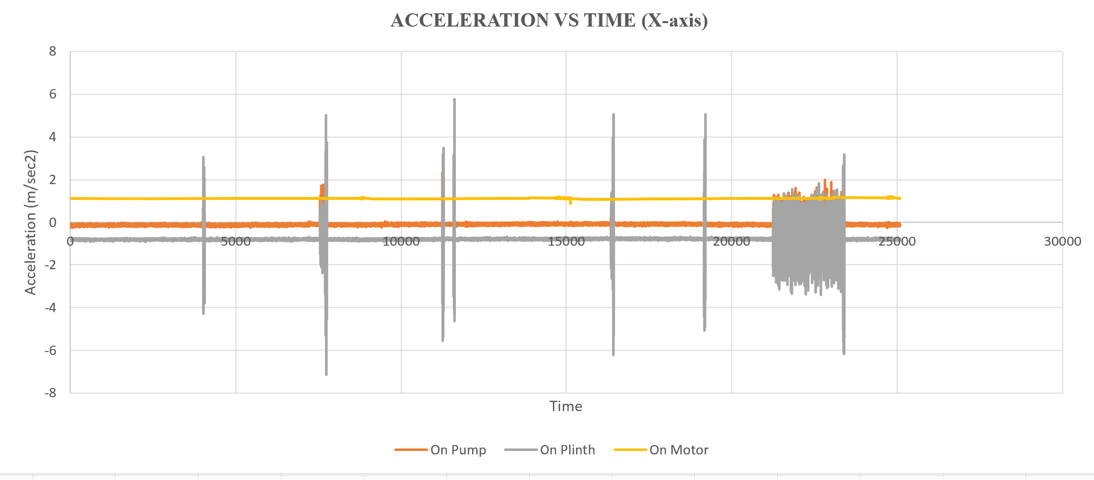
PUMP HOUSE-3 DATA

Slide 16
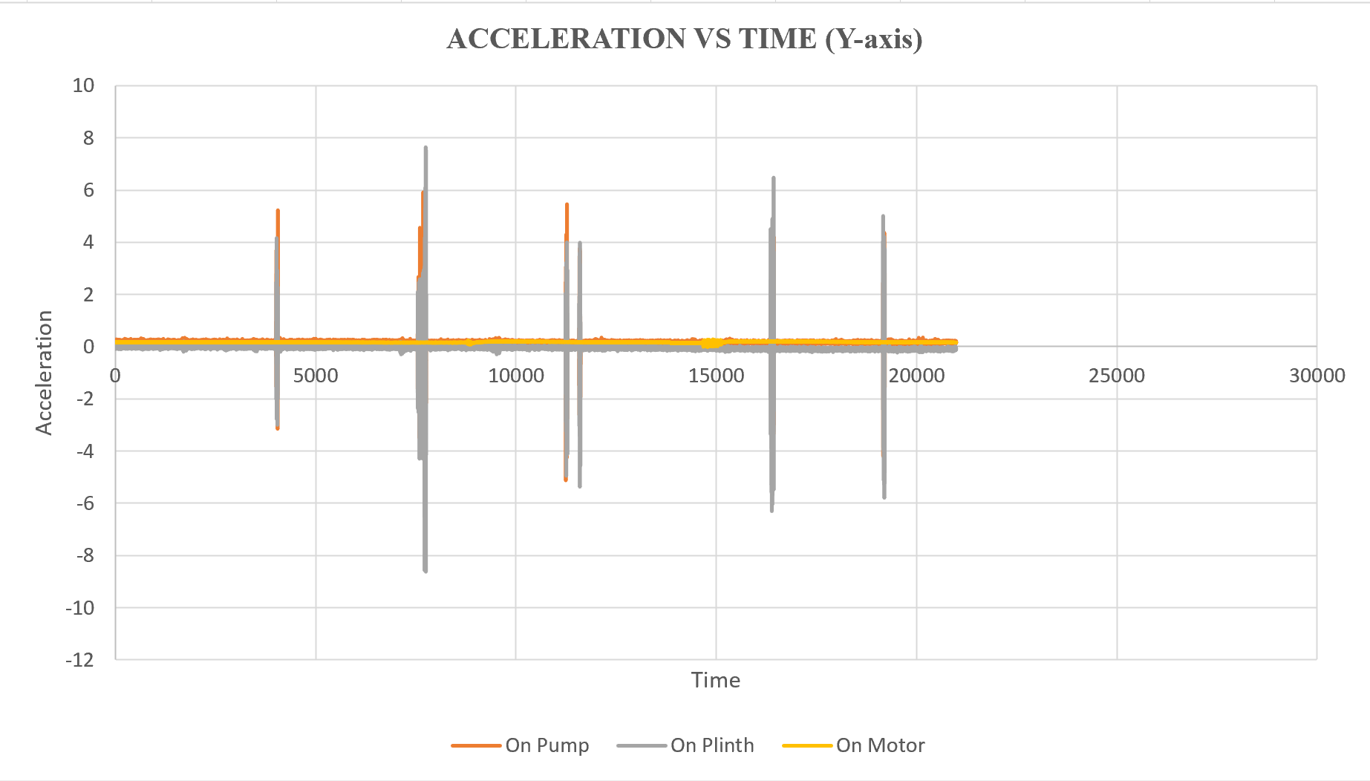
PUMP HOUSE-3 DATA

Slide 17
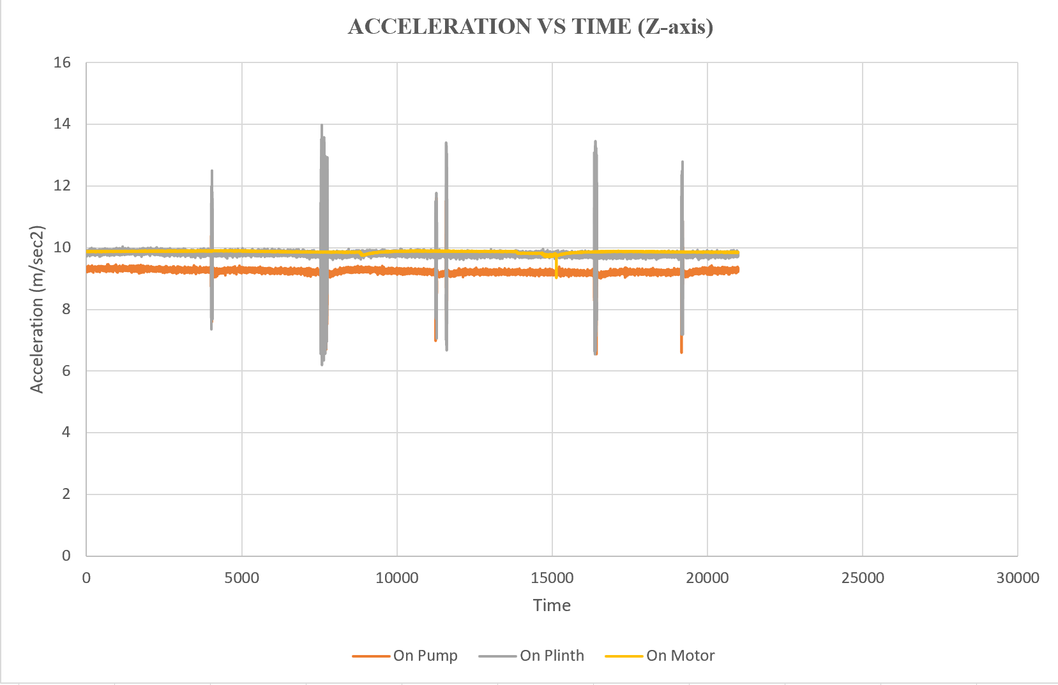
PUMP HOUSE-3 DATA

Slide 18
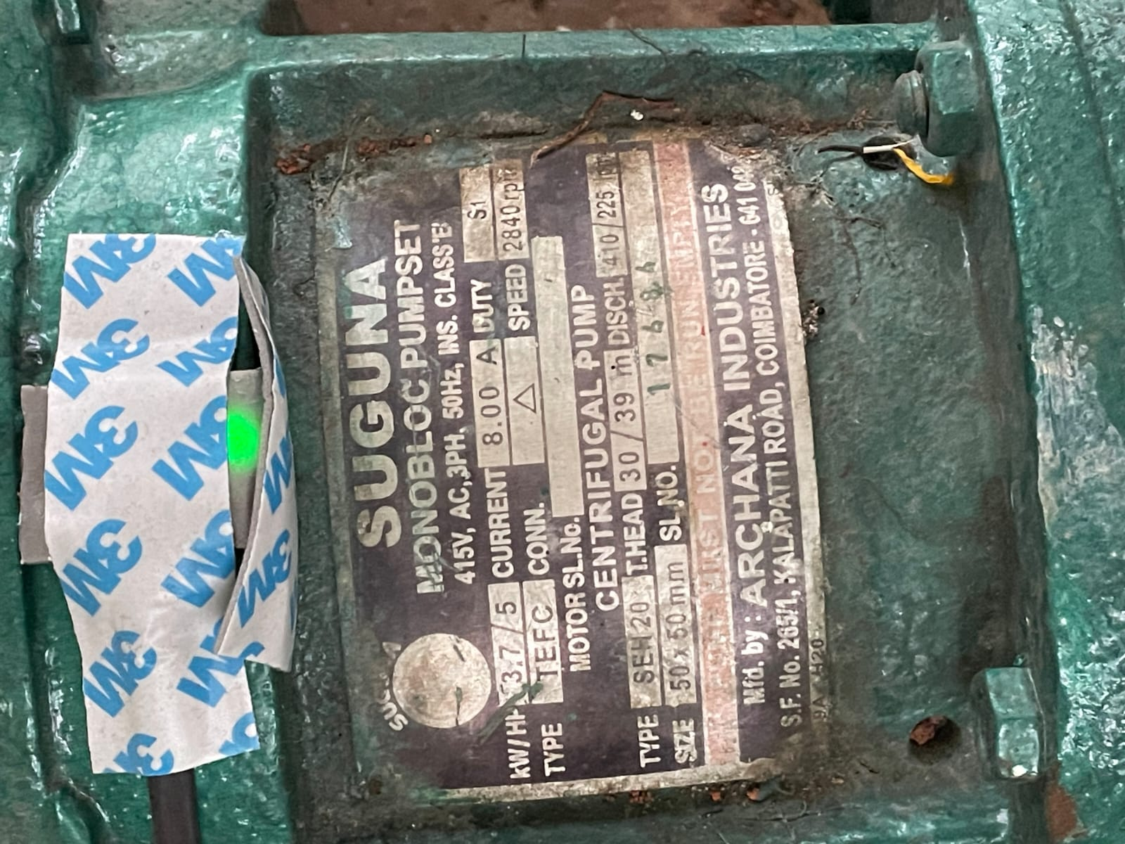
ANALYSIS OF PUMP HOUSE DATA
Pump Efficiency
With the help of acceleration-time data,we convert this data to velocity and then discharge and find out the power at the generated at the pump pipe.
Compare the results with the actual machine power to calculate the efficiency of the pump.
P = ρghQ
Q= Discharge
h = water head at which pump is working

Slide 19
ANALYSIS OF PUMP HOUSE DATA
Calculate the strength of concrete plinth which is supporting the structure.
To convert the acceleration into Force(by multiplying it by mass),
we compared the force with the strength of concrete(characteristic strength of concrete * Area).
Then we will check how much concrete is deteriorated because of the motor weight,water leakage etc. by comparing the force generated with the strength.
At the time when the force generated is more than its strength,concrete block will fail.

Slide 20
ANALYSIS OF PUMP HOUSE DATA
Data:
Mass of Concrete Block = 120kg
Avg. Acceleration Value = 9.83
Grade of Concrete = M30
Area of Concrete Block = 1X1 m
Strength = 30*1000*1000 = 30,000N
Force generated in Concrete Block Because of Motor = 120*9.835 = 120.30 N
For Now the strength is at par with force generated so block is safe.

Slide 21
ANALYSIS OF PUMP HOUSE DATA
Transfer of forces (in pipe)
The acceleration value which we got from the pump house water pipe is larger as compared to the acceleration value which we have taken from the sensor deployed at the body of pump.
Because the water is flowing through the pipe,so it create more vibration at the pipes as compared to its source of energy.
Transfer of Forces in Concrete Block:
The acceleration value which we got is less than the values which is coming from the pipe and the water pump motor, because of the stiffness of the concrete, less acceleration is generating in the concrete block as well due to some losses also acceleration got reduced in the concrete block.

Slide 22
THANKYOU

